Slide 1



2.1 To install 2 open-source and free softwares:
2.2 To download some R Scripts (text file with commands)
Notes:
To start working we need to download and to install the softwares R and R studio. There are several options according to your computer, including for old versions. Here, we show you the links for free versions.
As well, we need some scripts for R, that are text files containing commands to perform a specific function
The following slides will show how to install R and R studio depending on your operative system.

Slide 2

INSTALLATION of R

Slide 3
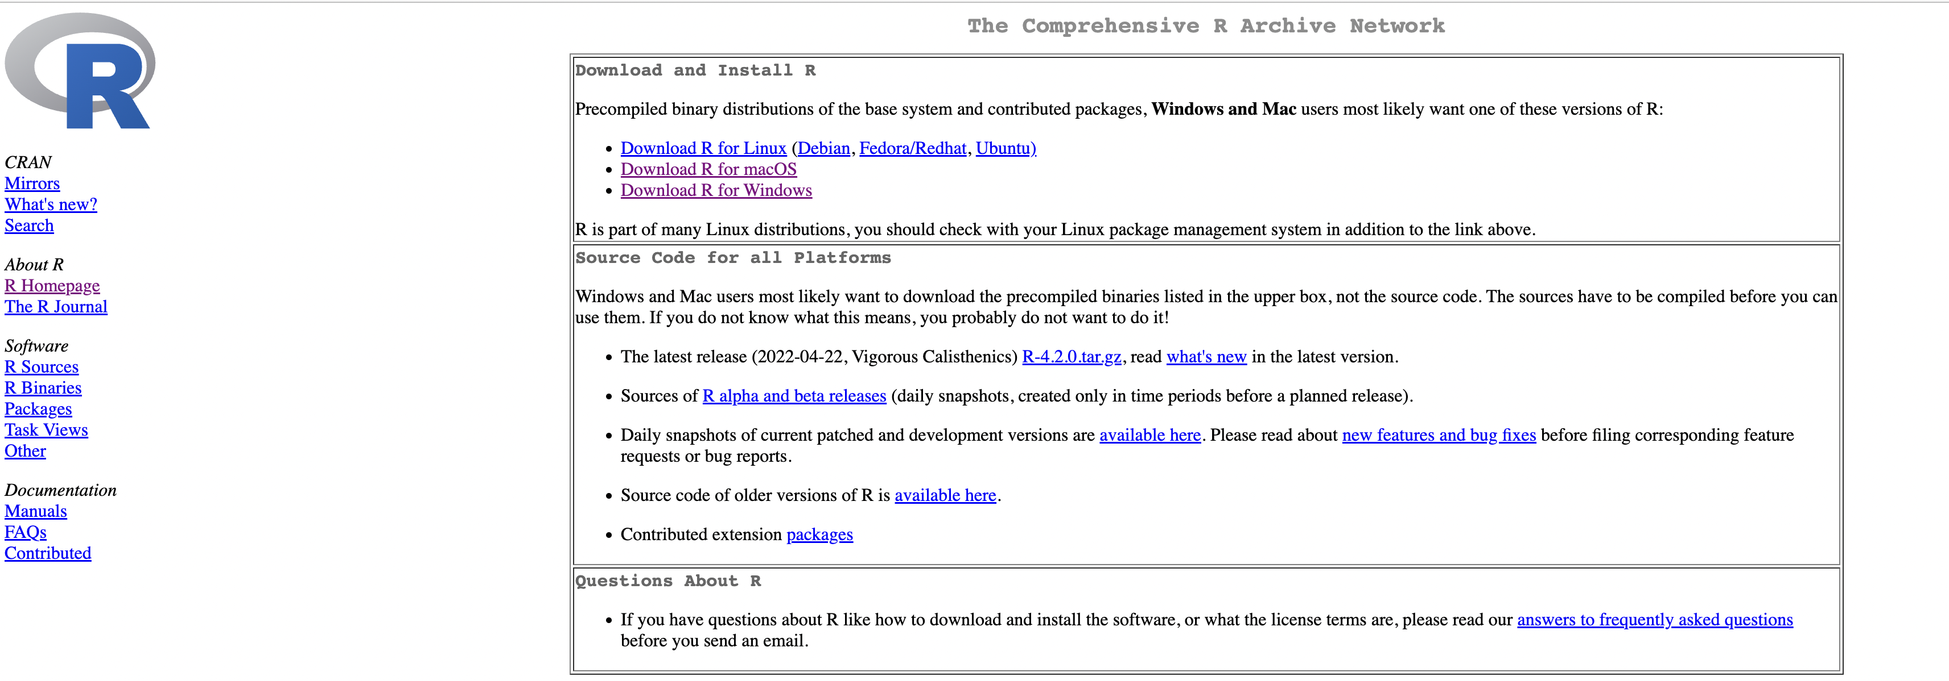

R Installation
R is available for free at: https://cran.r-project.org

Slide 4
INSTALLATION of R on Windows

Slide 5
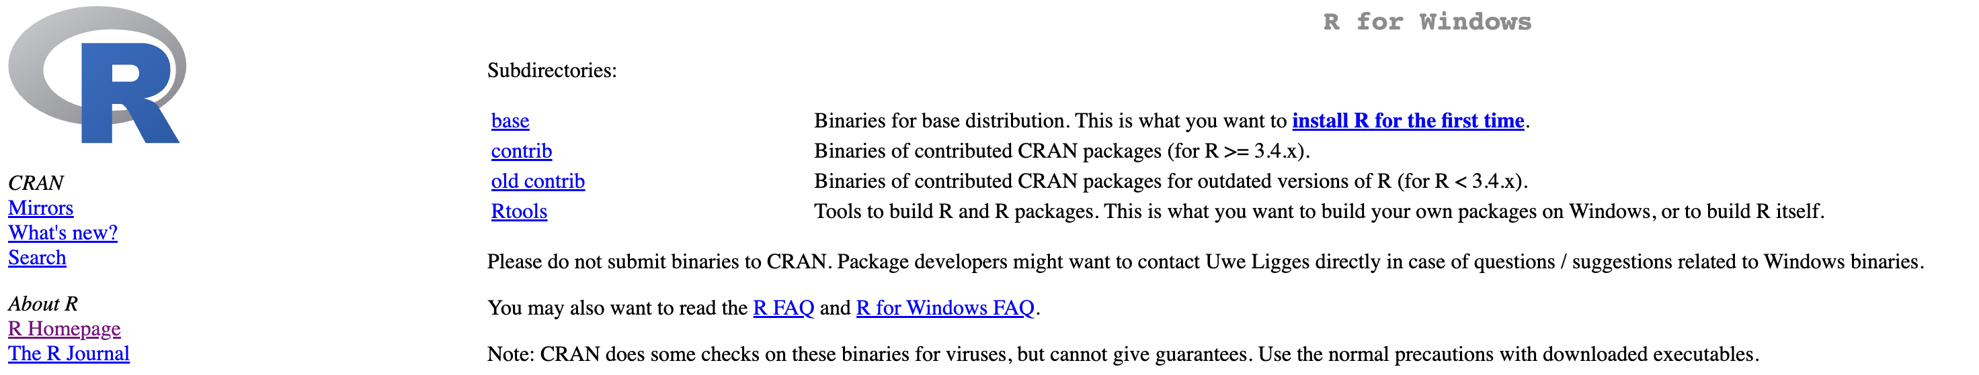
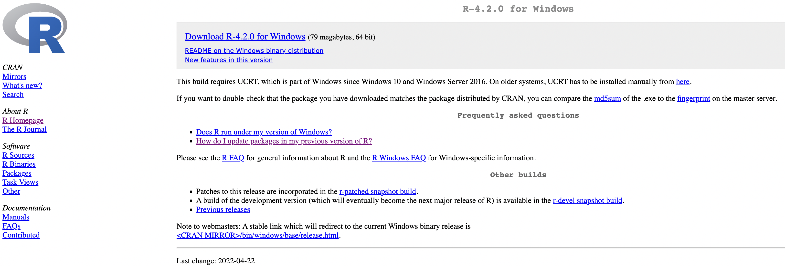
R Installation on Windows
1
Next page
2

Slide 6
INSTALLATION of R on MacOS

Slide 7
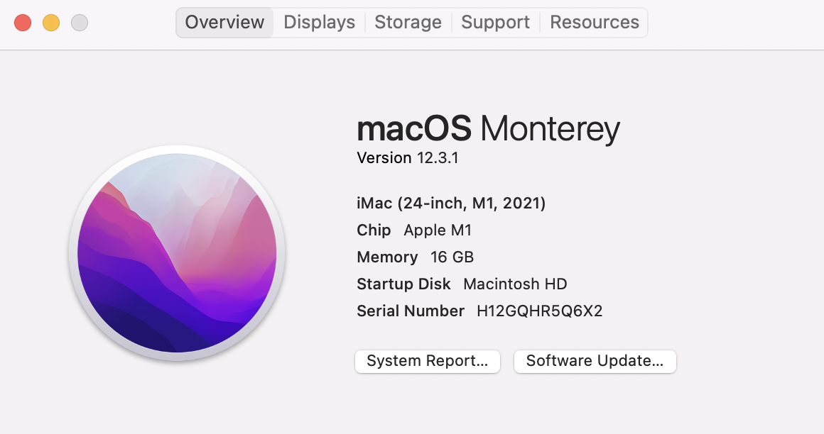
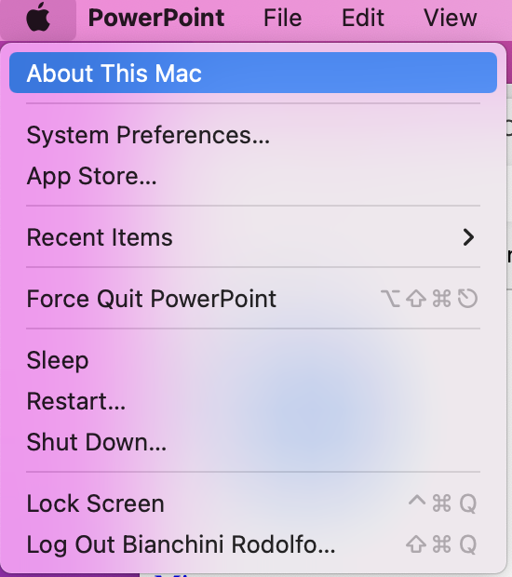
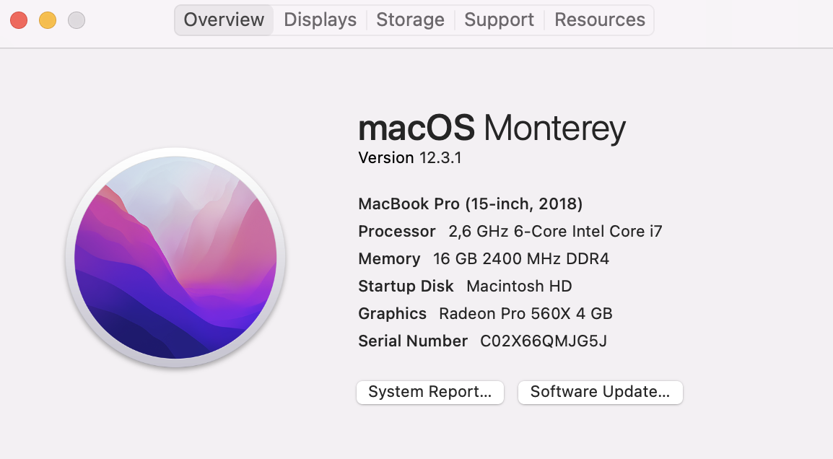
Which CPU is on my Mac?
1
2
macOS Apple M1 CPU
macOS Intel 64-bit CPU

Slide 8
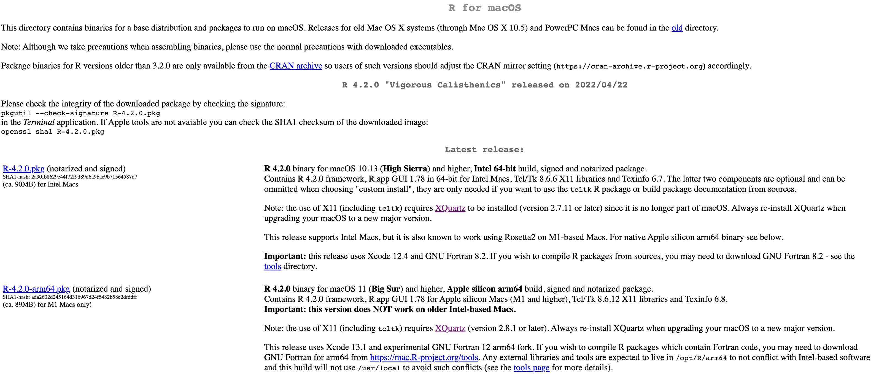
R Installation on macOS 10.13 and higher
R installation on macOS Intel 64-bit CPU
R installation on macOS Apple M1 CPU

Slide 9
R Installation on older macOS X
R installation on macOS 10.11 and higher
R installation on macOS 10.9 and higher
R installation on macOS 10.6 and higher

Slide 10
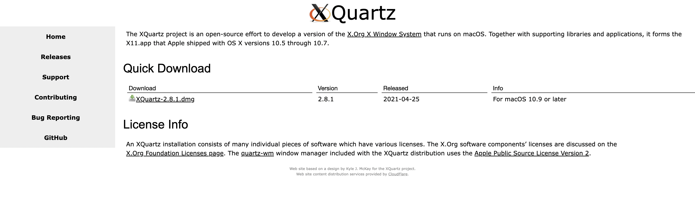
Installation of XQuartz on macOS 10.9 and higher
XQuartz is available for free at: https://www.xquartz.org/

Slide 11
INSTALLATION of RStudio

Slide 12
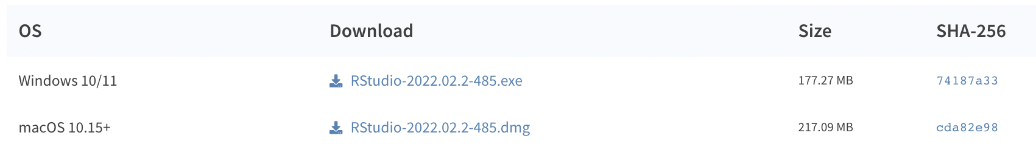
RStudio Installation
RStudio is available for free at: https://www.rstudio.com/products/rstudio/download/

Slide 13
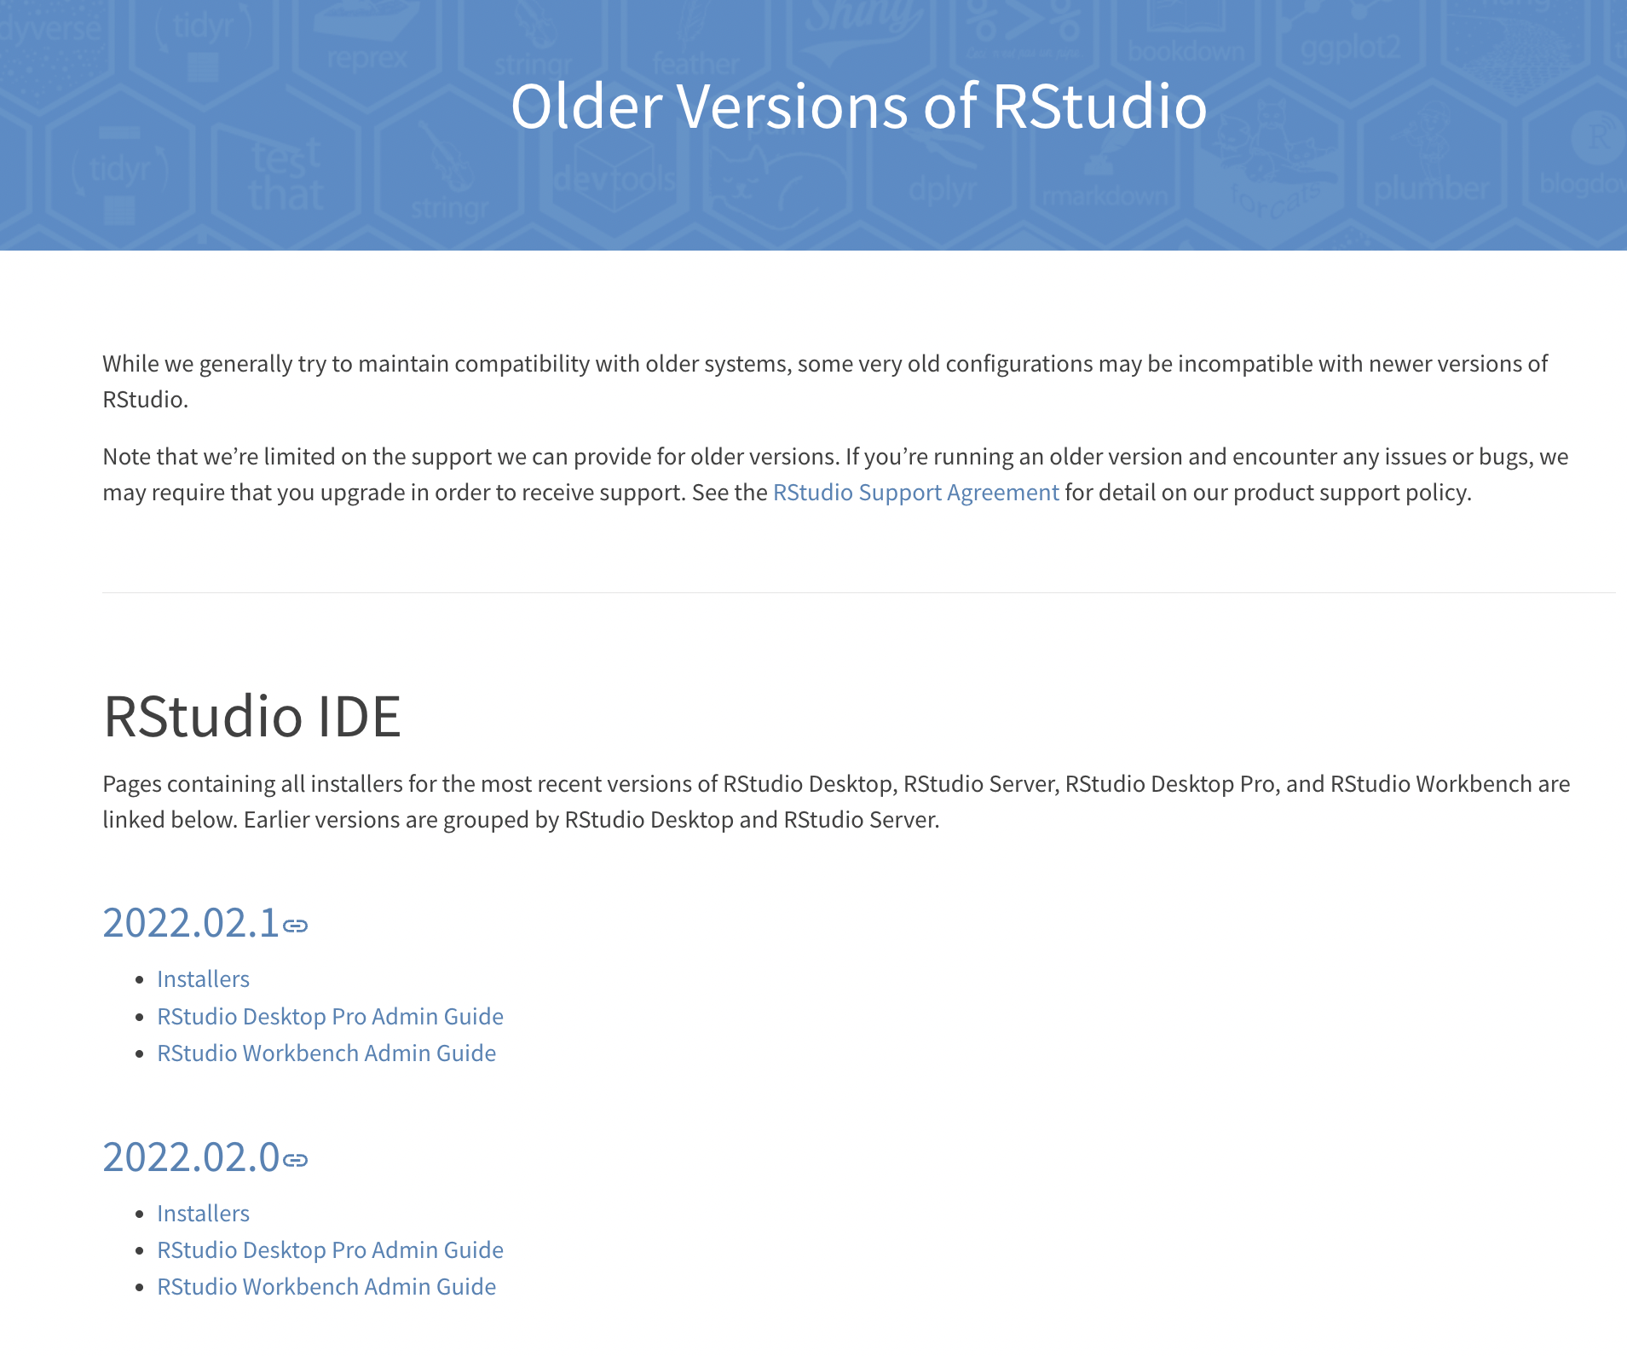
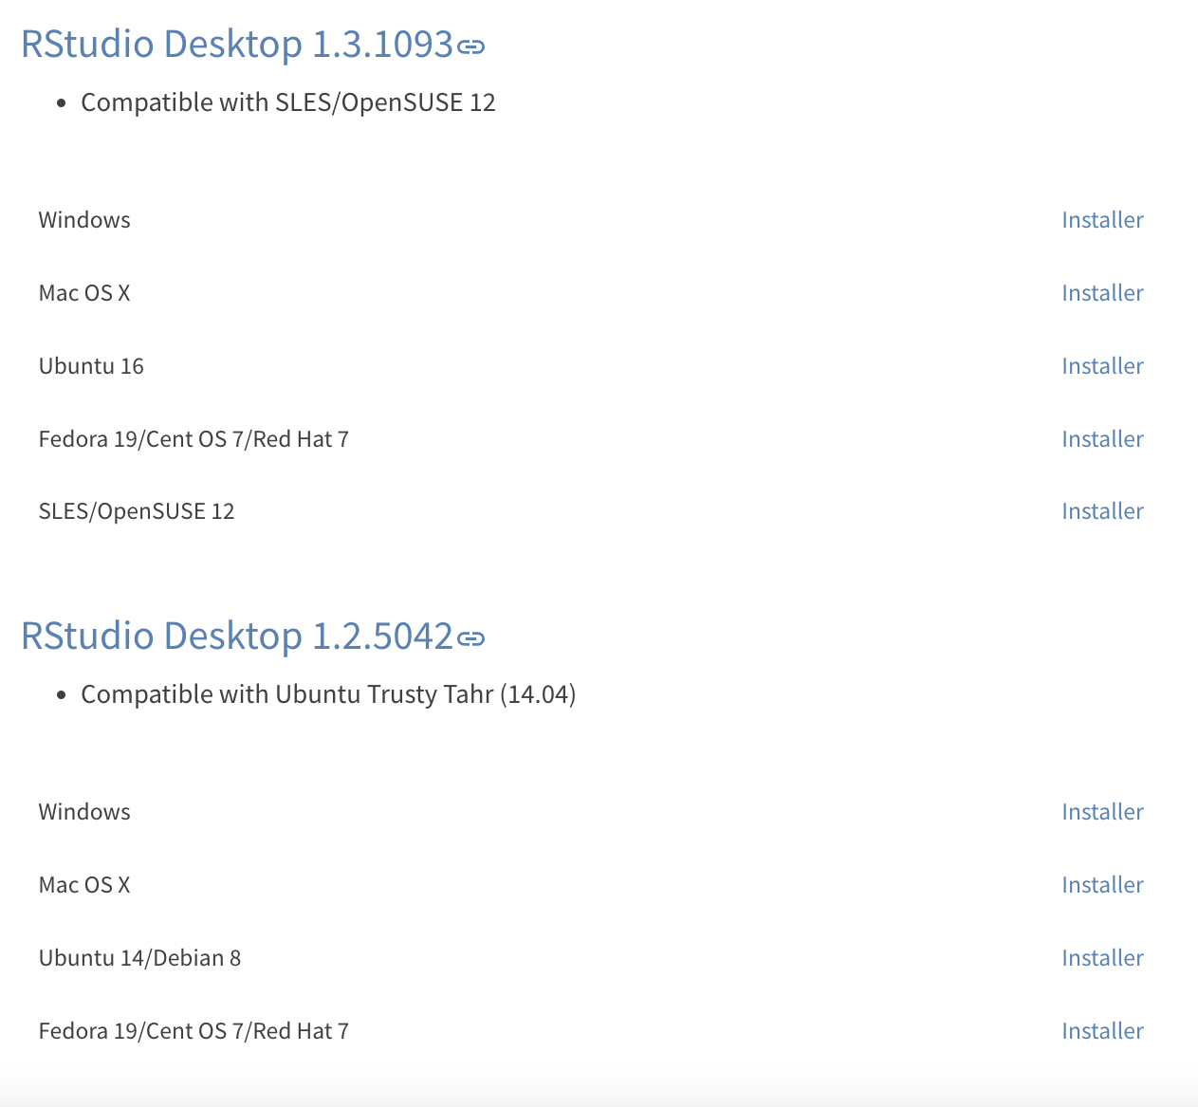
RStudio Installation on older Windows or MacOS
RStudio is available for free at: https://www.rstudio.com/products/rstudio/older-versions/#2021093
Scroll down
RStudio installation on macOS 10.11 and higher

